Slide 1
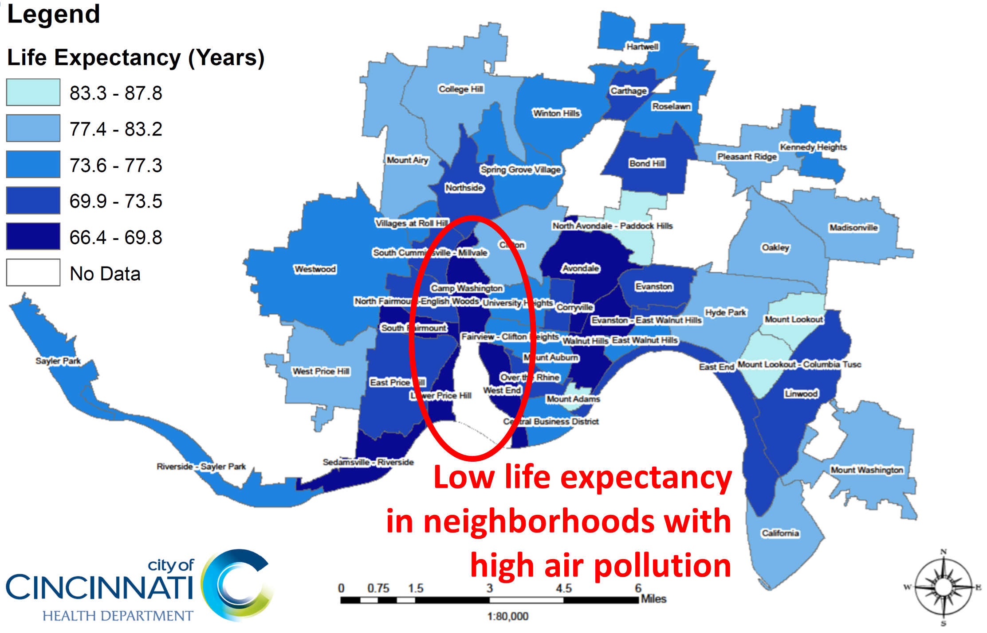
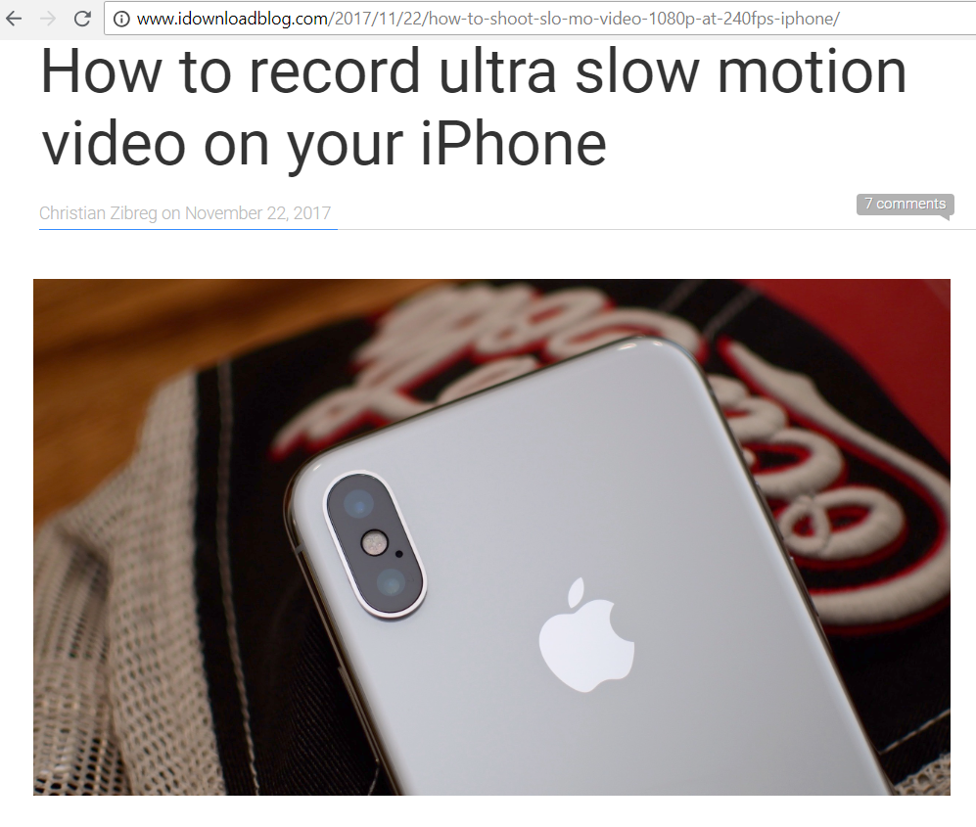
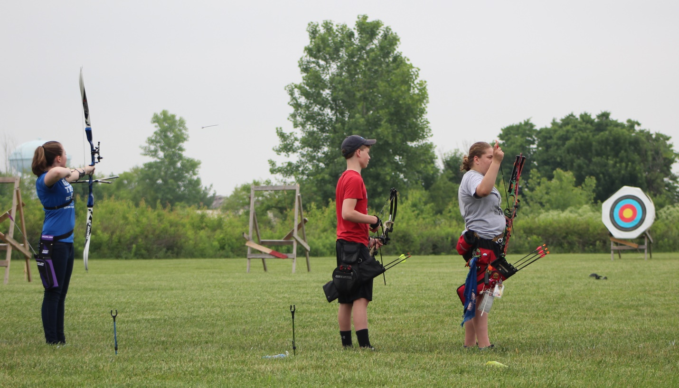
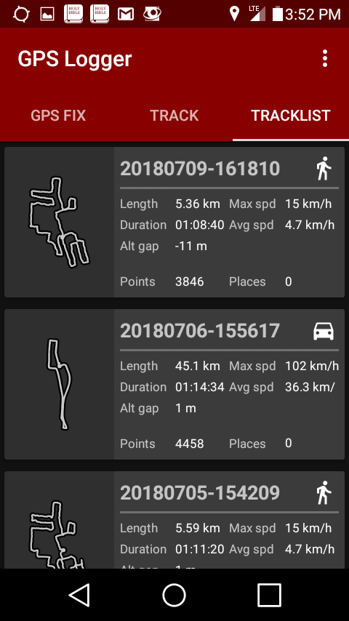
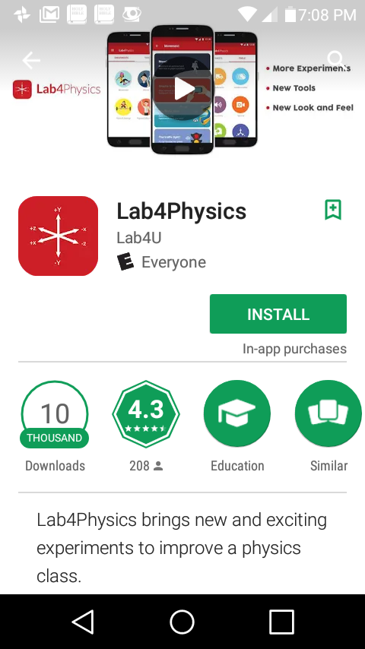
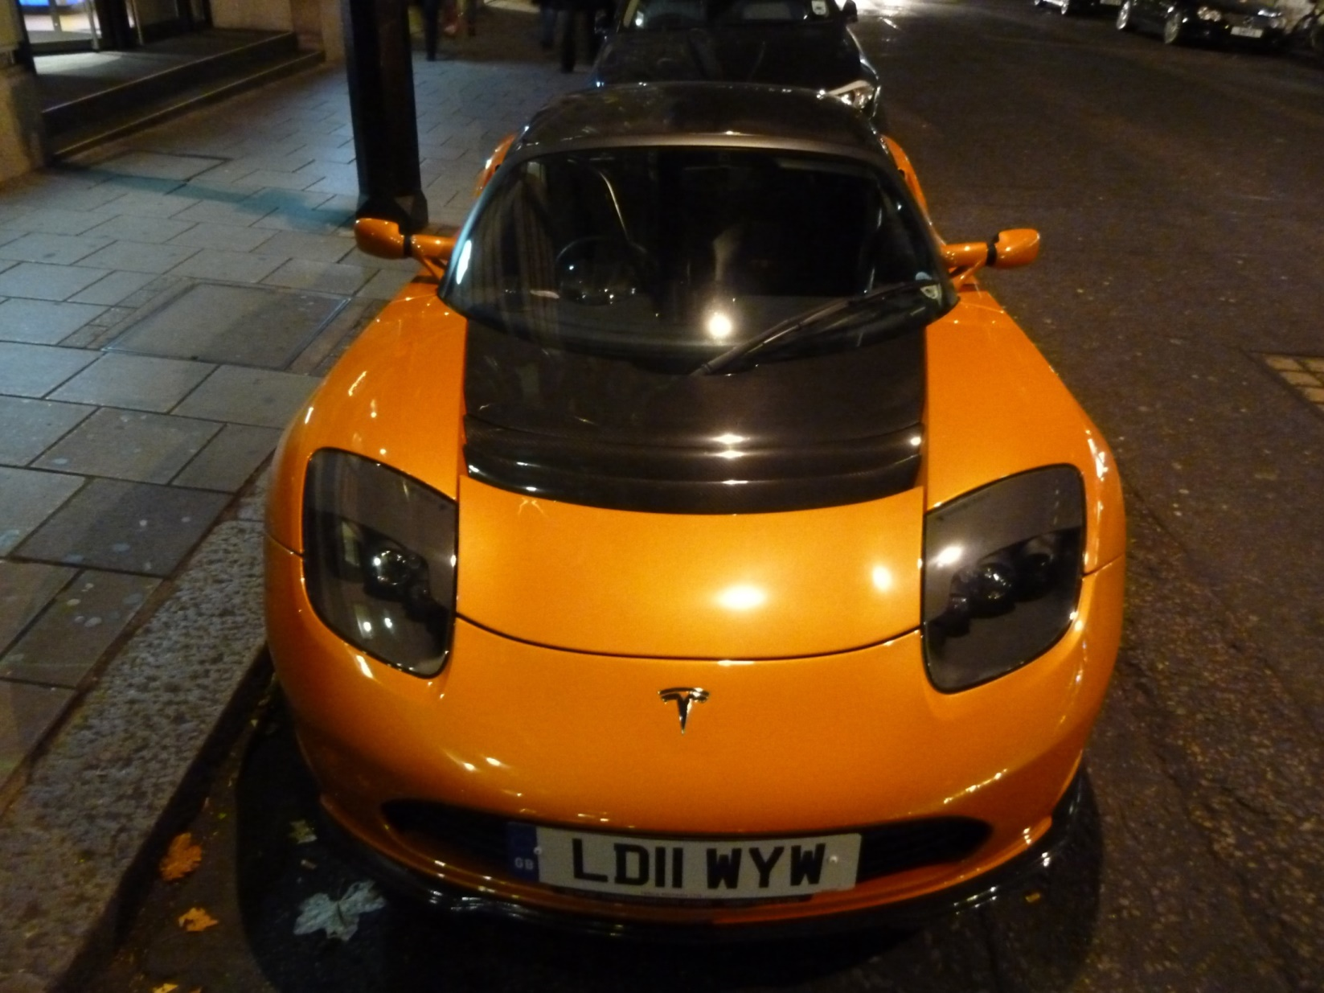
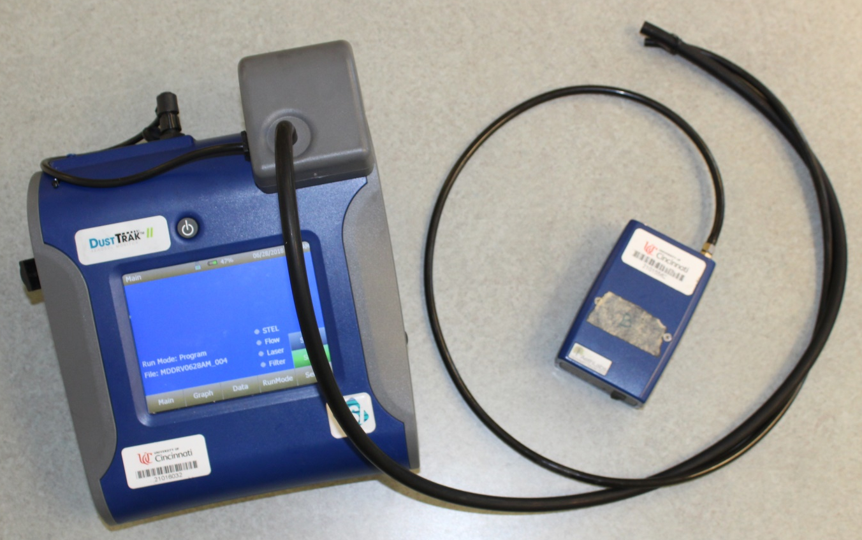
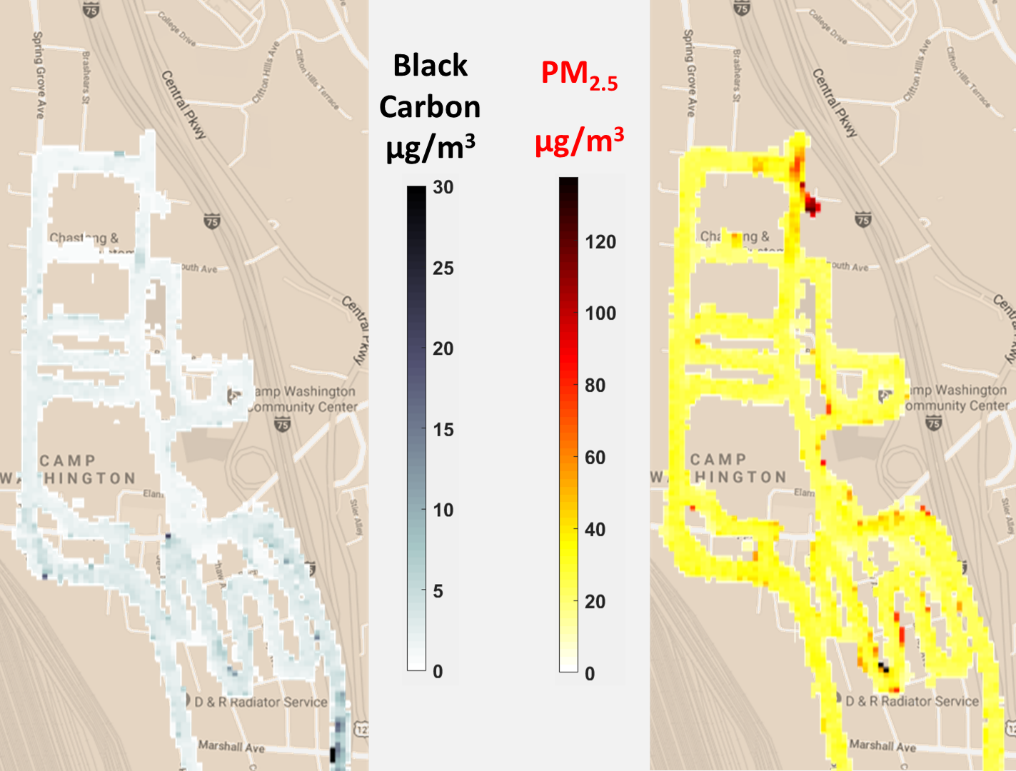
Physics is Everywhere
Dean Stocker Assistant Professor of Physics
UC Blue Ash College
RET is funded by the
National Science Foundation
Grant # EEC-1710826
Using the same skill set
and readily available tools,
in the classroom we can look at…
Physics in other stuff we care about:
In PHYS 1011 “Introduction to Physics,” students choose topics, collect and analyze data, and present results
Physics and Air Quality:
Research Experience for Teachers (RET)
Summer 2018
For three weeks we walked and drove through the Camp Washington neighborhood collecting data on air quality during morning and evening rush hours.
(photo credit: Ben – Tesla, Wikimedia Commons)
Engineering Design Process
Identify Alternatives
Identify and Define
Gather Information
Identify Alternatives
Identify and Define
Gather Information
There is significant variation in the levels of Black Carbon and Particulate Matter less than 2.5 μm in diameter (PM_{2.5}).
Refine
Refine
Communicate
Select Solutions
(photo credit: Jürgen from Sandesneben, Germany, Wikimedia Commons)
Communicate Solution
Evaluate Solution
Communicate Solution
Communicate Solution
Evaluate Solution
Implement Solution
Implement Solution
(map background from http://maps.google.com)
https://goo.gl/hwYiJv
Find more information on the wiki.

